Slide 1
Communications in a Connected World

Slide 2
1.1 Network Types
Notes:
1 – Communications in a Connected World
1.1 – Network Types

Slide 3

Network Types
Everything is Online
The internet has become such a part of everyday life that we almost take it for granted.
Normally, when people use the term internet, they are not referring to the physical connections in the real world. Rather, they tend to think of it as a formless collection of connections. It is the “place” people go to find or share information.
Notes:
1 – Communications in a Connected World
1.1 – Network Types
1.1.1 – Everything is Online

Slide 4
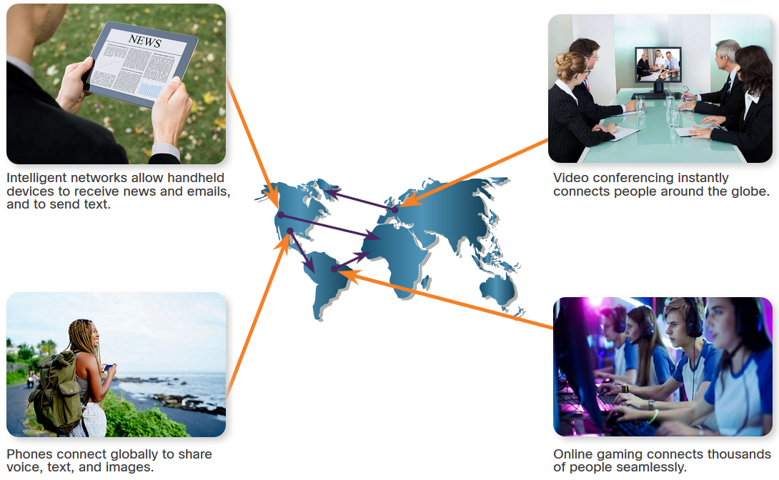
Network Types
Who Owns “The Internet”?
The internet is not owned by any individual or group. The internet is a worldwide collection of interconnected networks (internetwork or internet for short), cooperating with each other to exchange information using common standards.
Notes:
1 – Communications in a Connected World
1.1 – Network Types
1.1.2 – Who Owns “The Internet”?

Slide 5
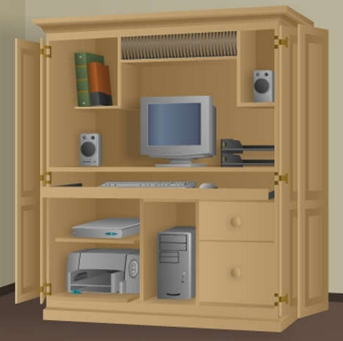

Network Types
Local Networks
Small home networks connect a few computers to each other and to the internet.
The SOHO network allows computers in a home office or a remote office to connect to a corporate network, or access centralized, shared resources.
Notes:
1 – Communications in a Connected World
1.1 – Network Types
1.1.3 – Local Networks

Slide 6
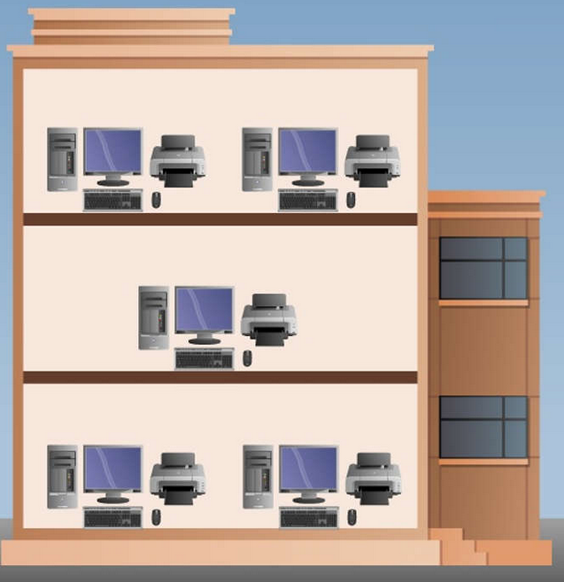
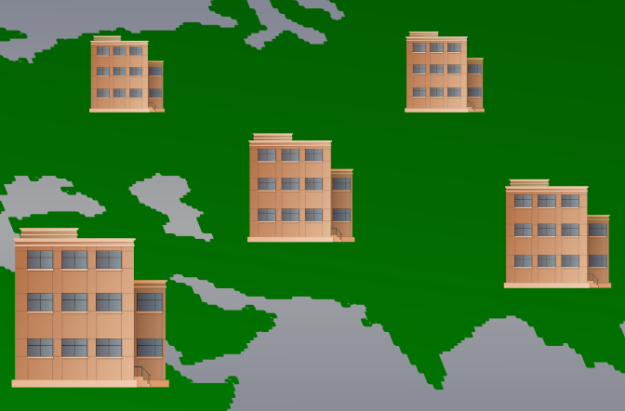
Network Types
Local Networks (Cont.)
Medium to large networks, such as those used by corporations and schools, can have many locations with hundreds or thousands of interconnected hosts.
The internet is a network of networks that connects hundreds of millions of computers world-wide.
Notes:
1 – Communications in a Connected World
1.1 – Network Types
1.1.3 – Local Networks (Cont.)

Slide 7
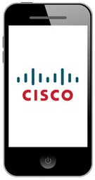
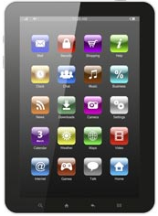
Network Types
Mobile Devices
Smart phones combine the functions of many different products together, such as a telephone, camera, GPS receiver, media player, and touch screen computer.
Tablets come with on-screen keyboards, so users are able to do many of the things they used to do on their laptop computer, such as composing emails or browsing the web.
Notes:
1 – Communications in a Connected World
1.1 – Network Types
1.1.5 – Mobile Devices

Slide 8
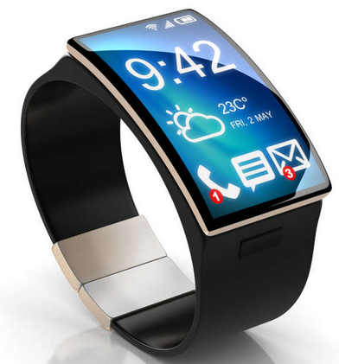
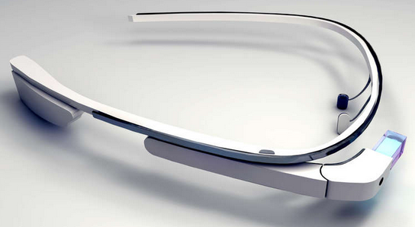
Network Types
Mobile Devices (Cont.)
A smartwatch can connect to a smart phone to provide the user with alerts and messages and other functions, such as heart rate monitoring and counting steps, can help people who are wearing the device to track their health.
A wearable computer in the form of glasses, such as Google Glass, contains a tiny screen that displays information to the wearer in a similar fashion to the Head-Up Display (HUD) of a fighter pilot.
Notes:
1 – Communications in a Connected World
1.1 – Network Types
1.1.5 – Mobile Devices (Cont.)

Slide 9
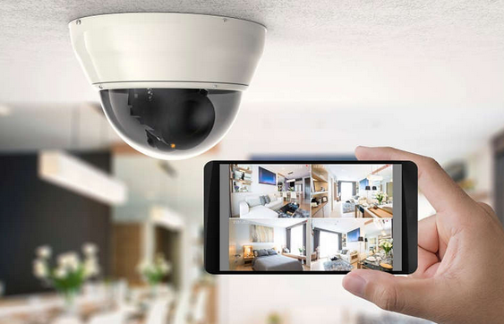
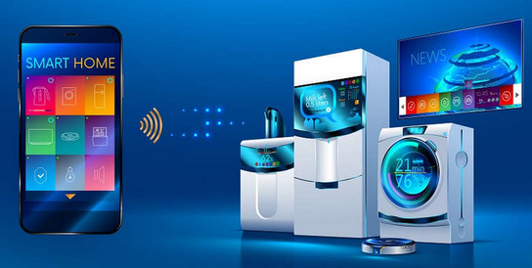
Network Types
Connected Home Devices
With a connected security system, many items in a home, such as lighting and climate controls, can be monitored and configured remotely using a mobile device.
Household appliances such as refrigerators, ovens, and dishwashers can be connected to the internet.
Notes:
1 – Communications in a Connected World
1.1 – Network Types
1.1.6 – Connected Home Devices

Slide 10
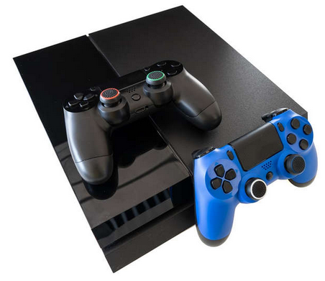
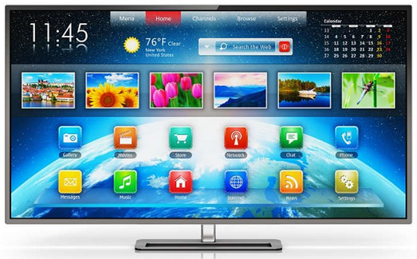
Network Types
Connected Home Devices (Cont.)
A smart TV can be connected to the internet to access content without the need for TV service provider equipment.
Gaming consoles can connect to the internet to download games and play with friends online.
Notes:
1 – Communications in a Connected World
1.1 – Network Types
1.1.6 – Connected Home Devices (Cont.)

Slide 11
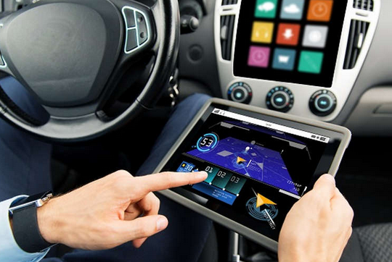
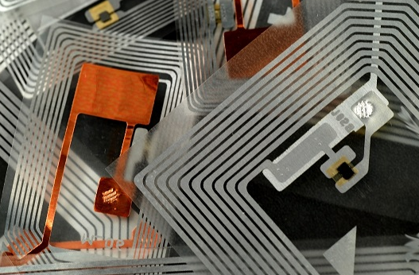
Network Types
Other Connected Devices
Many modern cars, known as Smart Cars, can connect to the internet to access maps, audio and video content, or information about a destination.
Radio frequency identification (RFIDs) tags can be placed in or on objects to track them or monitor sensors for many conditions.
Notes:
1 – Communications in a Connected World
1.1 – Network Types
1.1.7 – Other Connected Devices

Slide 12
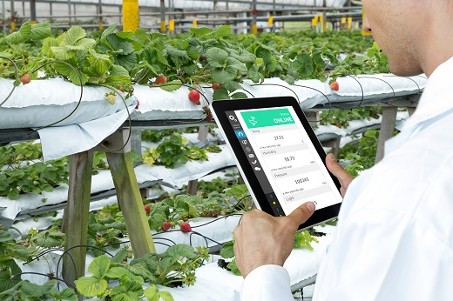
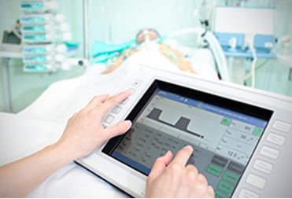
Network Types
Other Connected Devices (Cont.)
Connected sensors can provide temperature, humidity, wind speed, barometric pressure, and soil moisture data. Actuators can then be automatically triggered based on current conditions
Medical devices such as pacemakers, insulin pumps, and hospital monitors provide users or medical professionals with direct feedback or alerts when vital signs are at specific levels.
Notes:
1 – Communications in a Connected World
1.1 – Network Types
1.1.7 – Other Connected Devices (Cont.)
1.1.8 – Check Your Understanding – Network Types

Slide 13
1.2 Data Transmission
Notes:
1 – Communications in a Connected World
1.2 – Data Transmission

Slide 14
Data Transmission
Types of Personal Data
The following categories are used to classify types of personal data:
Volunteered data - This is created and explicitly shared by individuals, such as social network profiles. This type of data might include video files, pictures, text or audio files.
Observed data - This is captured by recording the actions of individuals, such as location data when using cell phones.
Inferred data - This is data such as a credit score, which is based on analysis of volunteered or observed data.
Notes:
1 – Communications in a Connected World
1.2 – Data Transmission
1.2.2 – Types of Personal Data

Slide 15
Data Transmission
The Bit
Did you know that computers and networks only work with binary digits, zeros and ones? Each bit can only have one of two possible values, 0 or 1. The term bit is an abbreviation of “binary digit” and represents the smallest piece of data. Humans interpret words and pictures, computers interpret only patterns of bits. Each group of eight bits, such as the representations of letters and numbers, is known as a byte.
Using the American Standard Code for Information Interchange (ASCII), each character is represented by eight bits. For example:
Capital letter: A = 01000001
Number: 9 = 00111001
Special character: # = 00100011
This page includes an ASCII bit translation engine where you can enter any character and see the 8 bit translation.
Notes:
1 – Communications in a Connected World
1.2 – Data Transmission
1.2.3 – The Bit

Slide 16
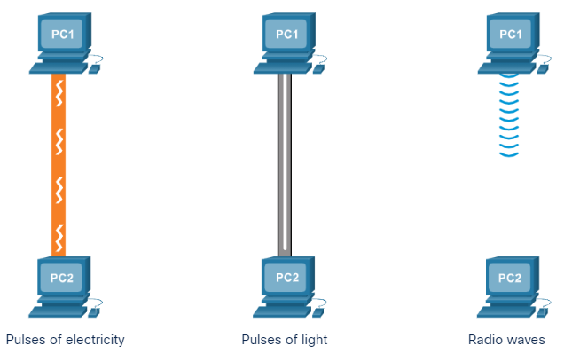
Data Transmission
Common Methods of Data Transmission
After the data is transformed into a series of bits, it must be converted into signals that can be sent across the network media to its destination. Media refers to the physical medium on which the signals are transmitted. Examples of media are copper wire, fiber-optic cable, and electromagnetic waves through the air. A signal consists of electrical or optical patterns that are transmitted from one connected device to another.
There are three common methods of signal transmission used in networks:
Electrical signals - Transmission is achieved by representing data as electrical pulses on copper wire.
Optical signals - Transmission is achieved by converting the electrical signals into light pulses.
Wireless signals - Transmission is achieved by using infrared, microwave, or radio waves through the air.
Notes:
1 – Communications in a Connected World
1.2 – Data Transmission
1.2.4 – Common Methods of Data Transmission
1.2.5 – Check Your Understanding – Data Transmission

Slide 17
1.3 Bandwidth and Throughput
Notes:
1 – Communications in a Connected World
1.3 – Bandwidth and Throughput

Slide 18
Bandwidth and Throughput
Bandwidth
Bandwidth is the capacity of a medium to carry data. Digital bandwidth measures the amount of data that can flow from one place to another in a given amount of time. Bandwidth is typically measured in the number of bits that (theoretically) can be sent across the media in a second.
Unit of Bandwidth | Abbreviation | Equivalence
Bits per second | bps | 1 bps = fundamental unit of bandwidth
Kilobyte: Thousands of bits per second | kbps | 1 kbps = 1,000 bps = 10³ bps
Megabyte: Millions of bits per second | Mbps | 1 Mbps = 1,000,000 bps = 10⁶ bps
Gigabyte: Billions of bits per second | Gbps | 1 Gbps = 1,000,000,000 bps = 10⁹ bps
Terabyte: Trillions of bits per second | Tbps | 1 Tbps = 1,000,000,000,000 bps = 10¹² bps
Notes:
1 – Communications in a Connected World
1.3 – Bandwidth and Throughput
1.3.1 - Bandwidth

Slide 19
Bandwidth and Throughput
Throughput
Like bandwidth, throughput is the measure of the transfer of bits across the media over a given period of time. However, due to a number of factors, throughput does not usually match the specified bandwidth. Many factors influence throughput including:
The amount of data being sent and received over the connection
The types of data being transmitted
The latency created by the number of network devices encountered between source and destination
Latency refers to the amount of time, including delays, for data to travel from one given point to another.
Notes:
1 – Communications in a Connected World
1.3 – Bandwidth and Throughput
1.3.3 – Throughput
1.3.4 – Check Your Understanding – Bandwidth and Throughput

Slide 20
1.4 Clients and Servers
Notes:
1 – Communications in a Connected World
1.4 – Clients and Servers

Slide 21
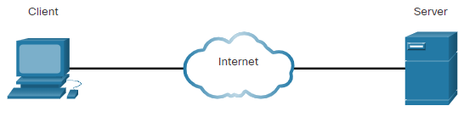
Clients and Servers
Clients and Server Connections
Clients and Servers Communicate together using the OSI (7-layered) model.
1st layer – physical layer. This is where the actual signals propagate ie electricity, light or RF
2nd Layer – physical identifier, known as data link layer. This is where each device is identified with a MAC address and is used for communications between bridges, switches & other layer 2 devices.
3rd Layer – logical identifier, known as network layer. This is where each device is identified with an IP address and allows segregation between networks
Notes:
1 – Communications in a Connected World
1.4 – Clients and Servers
1.4.1 – Clients and Server Roles

Slide 22
Clients and Servers
Clients and Server Connections
4th layer - the transport layer, responsible for connection between end systems, or hosts, and is ensures end-to-end error detection and recovery and flow control.
5th layer – session layer, sets up, manages, and ends connections and communication between applications
6th layer – presentation layer, it ensures that the data is transformed to the relevant form to enable communications.
7th layer - application layer, allows the support of all end-user applications
Notes:
1 – Communications in a Connected World
1.4 – Clients and Servers
1.4.1 – Clients and Server Roles

Slide 23
Clients and Servers
Clients and Server Roles
Clients are computer hosts that have software installed that enables the hosts to request and display the information obtained from the server. Servers are hosts that have software installed which enable them to provide information, like email or web pages, to other hosts on the network.
Type | Description
Email | The email server runs email server software. Clients use mail client software, such as Microsoft Outlook, to access email on the server.
Web | The web server runs web server software. Clients use browser software, such as Windows Internet Explorer, to access web pages on the server.
File | The file server stores corporate and user files in a central location. The client devices access these files with client software such as the Windows File Explorer.
Notes:
1 – Communications in a Connected World
1.4 – Clients and Servers
1.4.1 – Clients and Server Roles

Slide 24
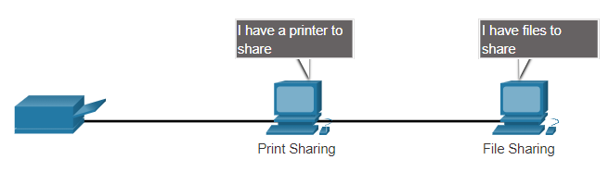
Clients and Servers
Peer-to-Peer Networks
In small businesses and homes, many computers function as the servers and clients on the network. This type of network is called a peer-to-peer (P2P) network. The simplest P2P network consists of two directly connected computers using either a wired or wireless connection.
Advantages of P2P:
Easy to set up
Less complex than other networks
Lower cost because network devices and dedicated servers may not be required
Can be used for simple tasks such as transferring files and sharing printers
Disadvantages of P2P:
No central administration
Not as secure as other networks
Not scalable
All devices may act as both clients and server which can slow their performance
Notes:
1 – Communications in a Connected World
1.4 – Clients and Servers
1.4.2 – Peer-to-Peer Networks

Slide 25
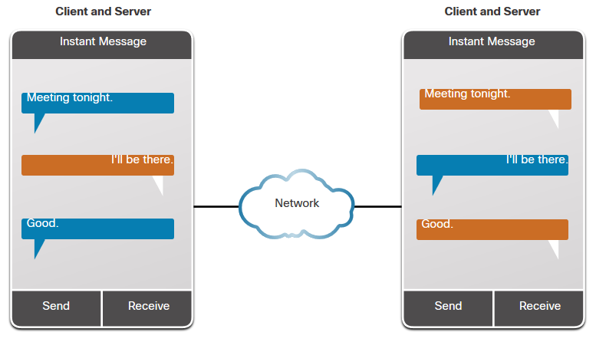
Clients and Servers
Peer-to-Peer Applications
A P2P application allows a device to act as both a client and a server within the same communication, as shown in the figure. In this model, every client is a server and every server is a client. P2P applications require that each end device provide a user interface and run a background service. In the figure, both clients can simultaneously send and receive messages.
Notes:
1 – Communications in a Connected World
1.4 – Clients and Servers
1.4.3 – Peer-to-Peer Applications

Slide 26
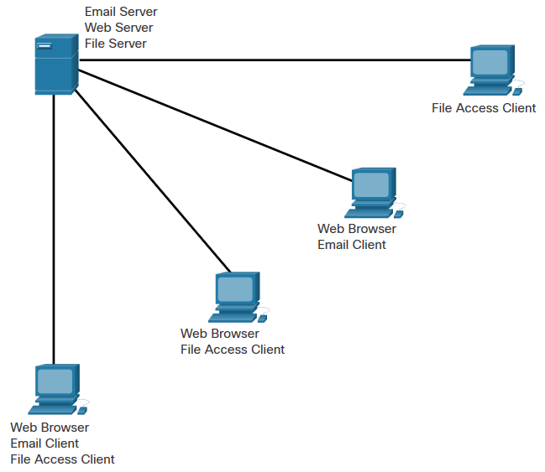
Clients and Servers
Multiple Roles in the Network
A computer with server software can provide services simultaneously to one or many clients, as shown in the figure. Additionally, a single computer can run multiple types of server software. In a home or small business, it may be necessary for one computer to act as a file server, a web server, and an email server.
Notes:
1 – Communications in a Connected World
1.4 – Clients and Servers
1.4.4 – Multiple Roles in the Network
1.4.5 – Check Your Understanding – Clients and Servers

Slide 27
1.5 Network Components
Notes:
1 – Communications in a Connected World
1.5 – Network Components

Slide 28
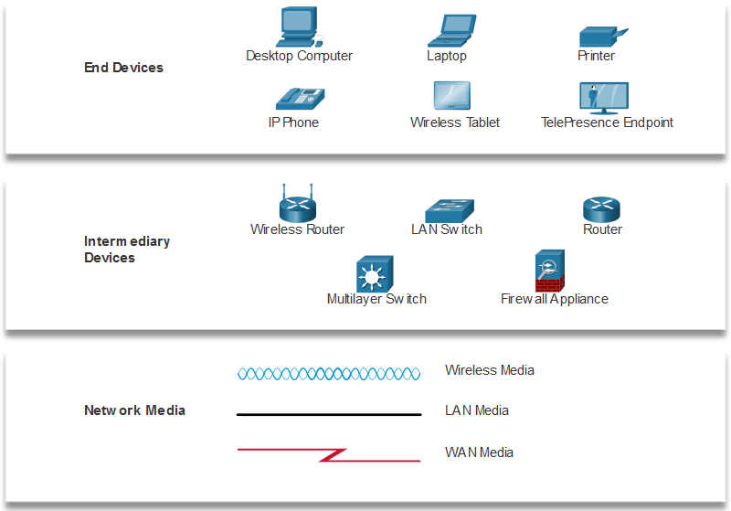
Network Components
Network Infrastructure
The network infrastructure contains three categories of hardware components, as shown in the figure:
End devices
Intermediate devices
Network media
Notes:
1 – Communications in a Connected World
1.5 – Network Components
1.5.2 – Network Infrastructure

Slide 29
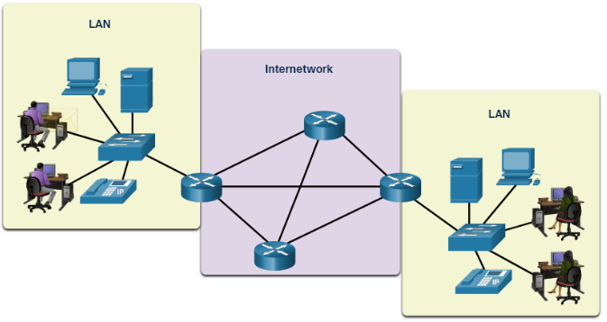
Network Components
End Devices
The network devices that people are most familiar with are called end devices, or hosts. These devices form the interface between users and the underlying communication network.
Some examples of end devices are as follows:
Computers (workstations, laptops, file servers, web servers)
Network printers
Telephones and teleconferencing equipment
Security cameras
Mobile devices (such as smart phones, tablets, PDAs, and wireless debit/credit card readers and barcode scanners)
Notes:
1 – Communications in a Connected World
1.5 – Network Components
1.5.3 – End Devices

Slide 30
Network Components
Lab - My Local Network
In this lab, you will complete the following objectives:
Record all the different network-attached devices in your home or classroom.
Investigate how each device connects to the network to send and receive information.
Create a diagram showing the topology of your network.
Label each device with its function within the network.
Notes:
1 – Communications in a Connected World
1.5 – Network Components
1.5.4 – Lab – My Local Network
1.5.5 – Check Your understanding – Identify End and Intermediary Devices

Slide 32
Communications in a Connected World Summary
What Did I Learn in this Module?
The internet is a worldwide collection of interconnected networks cooperating with each other to exchange information using common standards.
Some types of networks that you may use are small home, SOHO, medium to large networks such as those created by corporations and schools, and the internet.
Mobile devices include smart phones, tablets, smart watches, and smart glasses.
Connected home devices include security systems, smart appliances and TVs, and gaming consoles.
Other connected devices include smart cars, RFIDs, sensors/actuators, and medical devices.
Types of personal data are categorized as volunteered, observed, and inferred.
Each bit can only have one of two possible values, 0 or 1. Each group of eight bits is known as a byte.
There are three common methods of signal transmission used in networks: electrical signals, optical signals, and wireless signals.
Bandwidth is typically measured in the number of bits that (theoretically) can be sent across the media in a second.
Many factors influence throughput including: the amount of data being sent and received over the connection, the types of data being transmitted, and the latency created by the number of network devices encountered between source and destination. You can measure your throughput by going to speedtest.net.
Notes:
1 – Communications in a Connected World
1.6 – Communications in a Connected World Summary
1.6.1 – What Did I Learn in this Module?

Slide 33
Communications in a Connected World Summary
What Did I Learn in this Module? (Cont.)
Clients are computer hosts that have software installed that enables the hosts to request and display the information obtained from the server. Servers are hosts that have software installed which enable them to provide information, like email or web pages, to other hosts on the network.
The simplest P2P network consists of two directly connected computers using either a wired or wireless connection.
A P2P application allows a device to act as both a client and a server within the same communication.
A computer with server software can provide services simultaneously to one or many clients. Additionally, a single computer can run multiple types of server software.
The network infrastructure contains three categories of hardware components: end devices, intermediate devices, and network media.
The network devices that people are most familiar with are called end devices, or hosts. These devices form the interface between users and the underlying communication network.
Notes:
1 – Communications in a Connected World
1.6 – Communications in a Connected World Summary
1.6.1 – What Did I Learn in this Module? (Cont.)
16.2 – Module Quiz – Communications in a Connected World Quiz

Slide 34
Communications in a Connected World Summary
Module 1 – New Terms and Commands
internet
small home network
small office and home office (SOHO) network
medium to large network
smartphone
tablet
smartwatch
smart glasses
connected home devices
smart car
RFID tag
sensor
actuator
volunteered data
observed data
inferred data
bit
American Standard Code for Information Interchange (ASCII)
media
electrical signal
optical signal
wireless signal
bandwidth
throughput
bits per second (bps)
kilobyte (kbps)
megabyte (Mbps)
gigabyte (Gbps)
terabyte (TBps)
client
server
email server
web server
file server
peer-to-peer (P2P) network
peer-to-peer applications
end device
intermediate (intermediary) device
network media
wireless router
LAN switch
router
multilayer switch
firewall appliance
wireless media
LAN media
WAN media

